Slide 1
MODULE 5 GRAPH DATA STRUCTURE

Slide 2
A graph data structure is a collection of nodes that have data and are connected to other nodes.
Example
On Facebook, everything is a node.
It includes User, Photo, Album, Event, Group, Page, Comment, Story, Video, Link, Note...anything that has data is a node.
Every relationship is an edge from one node to another.
Whether you post a photo, join a group, like a page, etc., a new edge is created for that relationship.

Slide 3
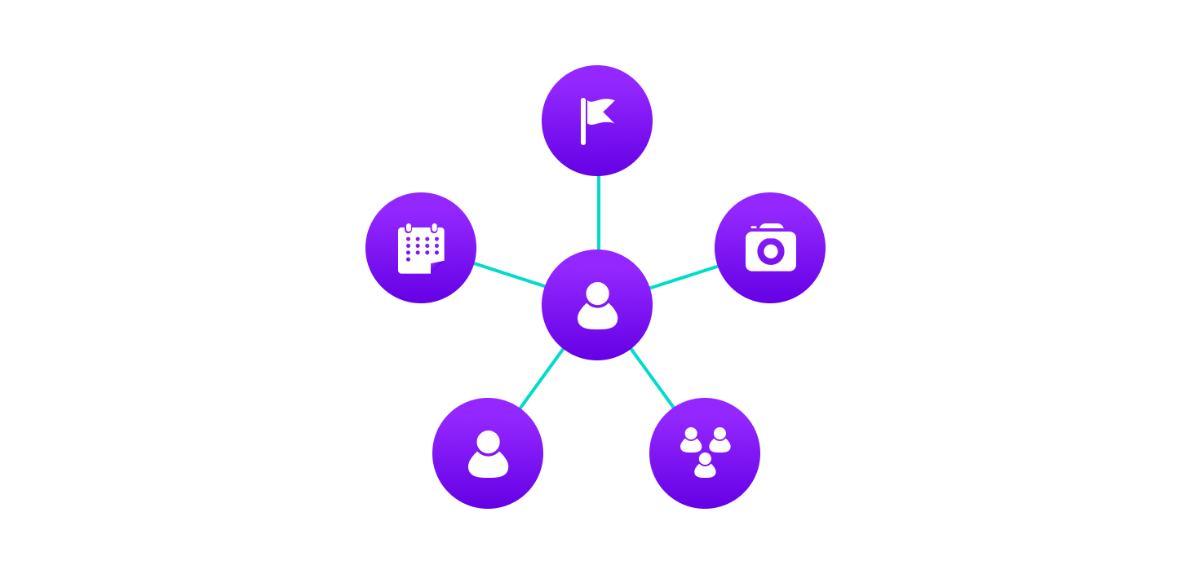

Slide 4
More precisely, a graph is a data structure (V, E) that consists of
A collection of vertices V
A collection of edges E, represented as ordered pairs of vertices (u,v)

Slide 5

Example

Slide 6
In the graph,
V = {0, 1, 2, 3}
E = {(0,1), (0,2), (0,3), (1,2)}
G = {V, E}

Slide 7
Graph Terminology
Adjacency: A vertex is said to be adjacent to another vertex if there is an edge connecting them. Vertices 2 and 3 are not adjacent because there is no edge between them.
Path: A sequence of edges that allows you to go from vertex A to vertex B is called a path. 0-1, 1-2 and 0-2 are paths from vertex 0 to vertex 2.
Directed Graph: A graph in which an edge (u,v) doesn't necessarily mean that there is an edge (v, u) as well. The edges in such a graph are represented by arrows to show the direction of the edge.

Slide 8
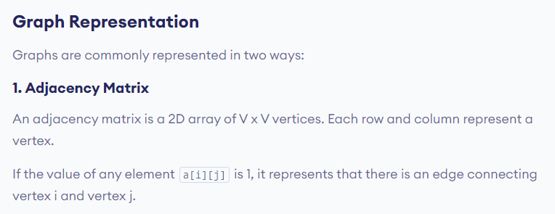

Slide 9
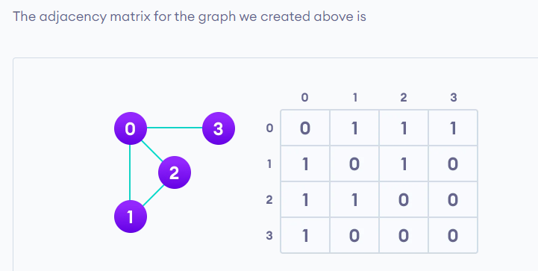

Slide 10
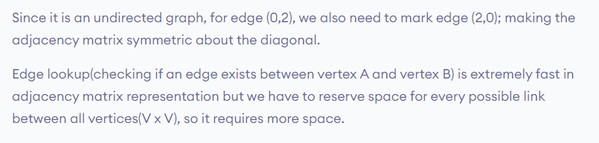

Slide 11
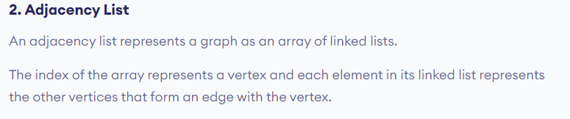

Slide 12
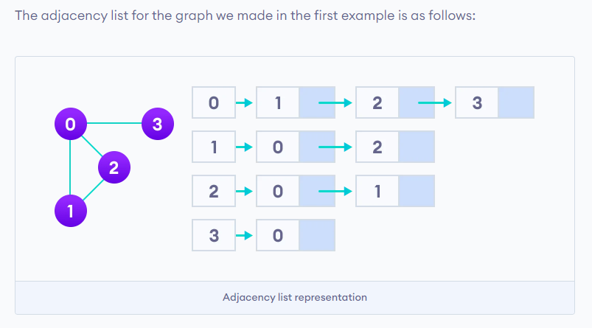

Slide 13
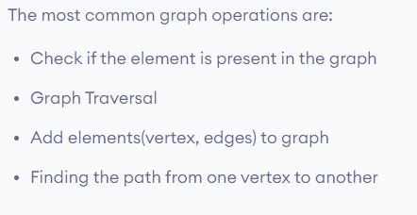
Graph Operations

